Slide 1

Cloud Platform Modernization
March 27, 2024

Slide 2

Business problem and Objectives
Digital Business Transformation
Business Problem
Digital Operations Transformation
Objectives
Operational silos leading to fragmented data.
Performance bottlenecks affecting data availability.
Aging Architecture using Teradata as EDW.
Lack of a single version of truth across the enterprise.
Manual reporting on Excel and limited executive-level dashboards.
Limited support for modern analytics tools and data sources.
Develop a scalable Data and Analytics Infrastructure on the cloud.
Enable data availability across different entities of the organization.
Ingest a variety of data sources efficiently.
Leverage a common infrastructure to overcome performance bottlenecks and reduce costs.
Reduce new ETL and BI development effort with increased productivity.
Support operational and BI reporting & dashboards, ad-hoc reporting, and analytical applications.

Slide 3
Agenda
Step 1: Extract data from various sources using S3 bucket and AWS Kinesis.
Step 2: Transform the data using AWS Glue.
Step 3: Load the cleaned data into S3 buckets and in Glue catalog using crawlers.
Step 4: Visualization and analysis using Athena notebook.

Slide 4
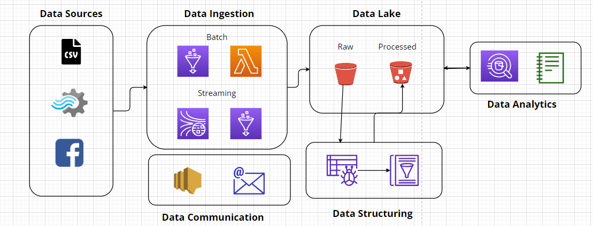
Data Architecture

Slide 5
Risk Mitigation Plan
Digital Business Transformation
Risks
Digital Operations Transformation
Mitigation Strategy
Data loss or corruption in S3 bucket or during the ETL process.
Security Breaches on unauthorized access to data during ETL stages.
Cost Overruns due to unexpected increases in AWS service costs could exceed budgeted amounts.
Implement regular data backups and validate data integrity after each stage of the ETL process. Use AWS services like Amazon S3 versioning.
Enforce strict IAM policies to control access to AWS resources. Encrypt data in transit and at rest. Implement monitoring and logging solutions like Amazon CloudWatch.
Set up AWS Budgets to track spending and receive alerts when costs exceed predefined thresholds. Implement resource tagging and cost allocation strategies to allocate expenses accurately.

Slide 6

Timeline
Milestones
5
Visualization
4
Integration
Utilizing built-in Athena notebook for visualization of cleaned data.
Using plotly, matplotlib, seaborn libraries for the visualization and noting down the insights from the visualizations.
3
Service Unit testing
Integrating all the services together into a single data pipeline in accordance with our data architecture.
Setting up SNS subscriptions.
Phases
2
Data Sources
Testing each and every required service separately by different team members.
Services: Kinesis, Glue, Athena, S3, Lambda, SNS etc.
1
Requirement Gathering
Gathering data sources for ingestion
Identifying various data sources. Generating Fake dataset wherever required
Understanding problem statement and gathering source data.
Brainstorming on the current drawbacks and identifying required AWS services.

Slide 7
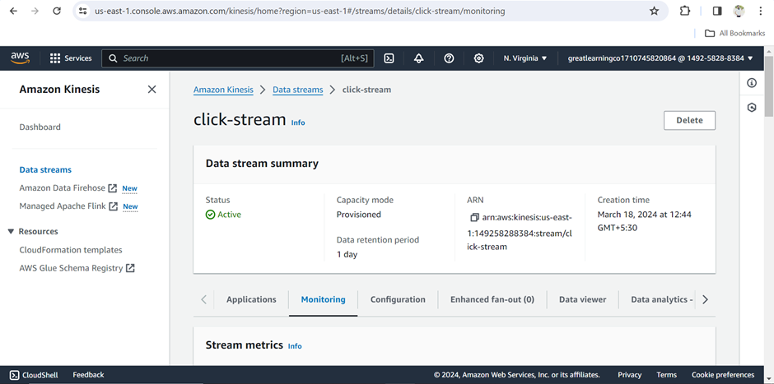
Step 1: Extract
Data Ingestion
Data is ingested into the cloud by uploading the CSVs in S3 buckets and streaming the data via AWS Kinesis.
Data sources
Streaming Data
clickstream and social media API data
Batch Data
csv files from marketing, sales and operations departments
Insert graphic here

Slide 8
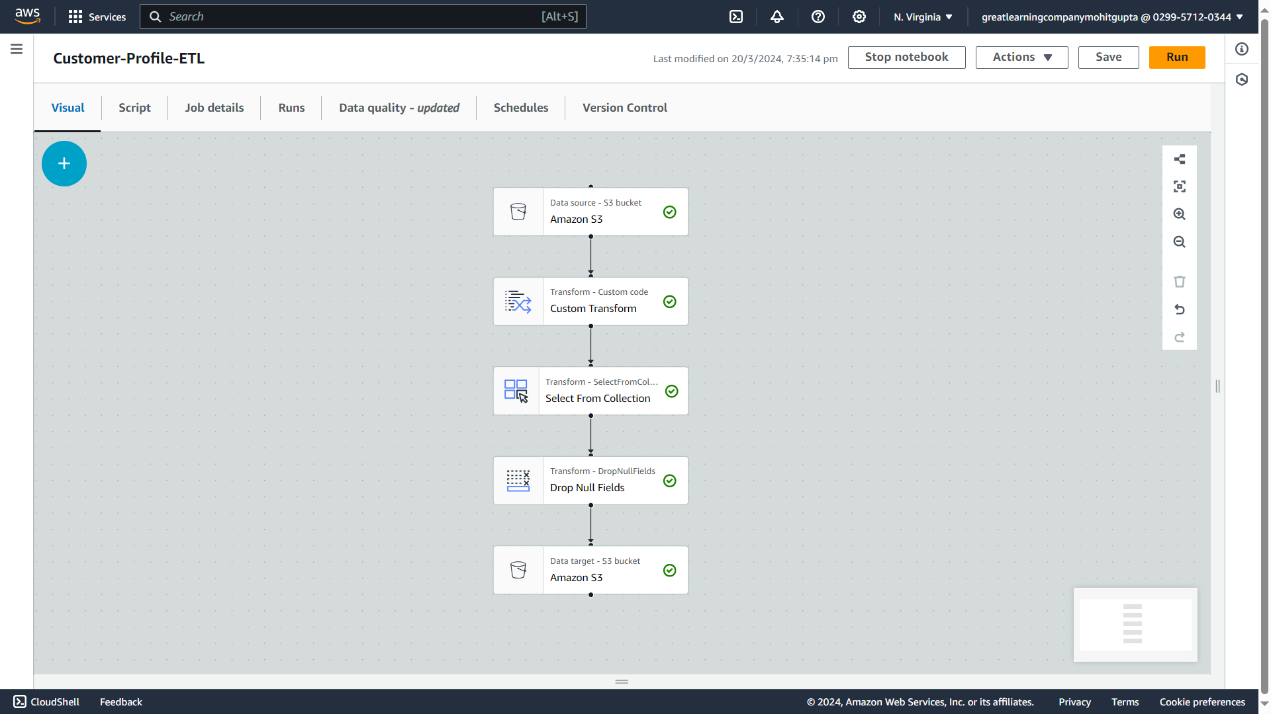
Step 2: Transform using AWS Glue
Data Processing
Utilize AWS Glue for data cataloging, metadata management, and ETL (Extract, Transform, Load) processes.
Create and manage data catalogs to provide a unified view of available data sources.
The Glue Crawler scans the data source, infers schema, and creates tables in the Glue Data Catalog.
AWS Glue Jobs execute data transformation logic on cataloged data, simplifying the data processing workflow

Slide 9





Glue Transforms
Custom Transform
Some dates in the dataset were of format dd-mm-yyyy while some were of format mm/dd/yyyy. All of these were replaced by the standard mm/dd/yyyy format. Also the leading zeros from the dates have been removed
To Timestamp
This transform is performed on the clickstream dataset where the timestamp column has the data in epoch format of Python(seconds). This transform converts that data into timestamp format.
Drop Null Fields
This transform drops the null fields.

Slide 10
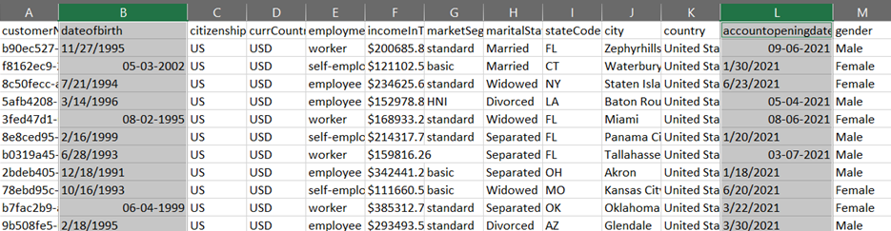
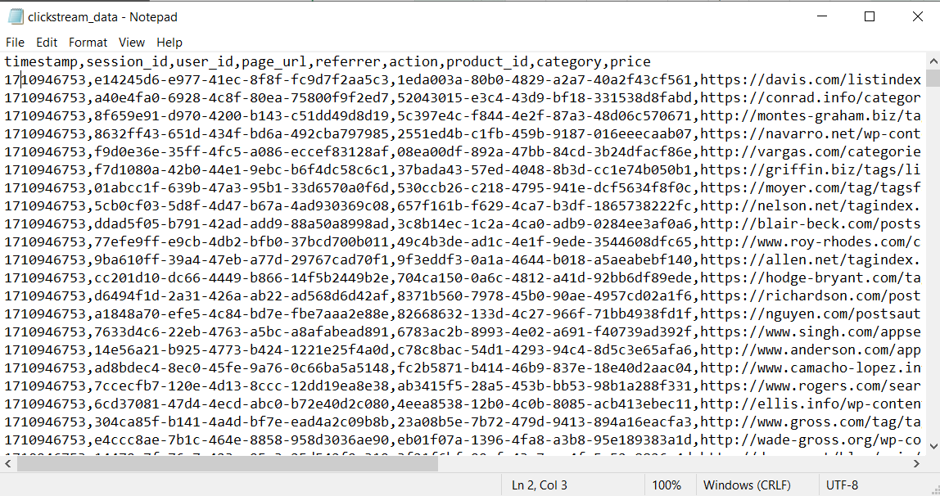
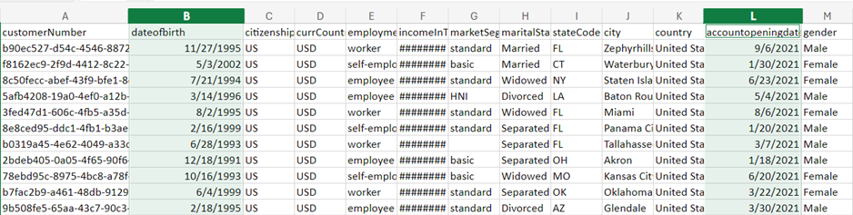
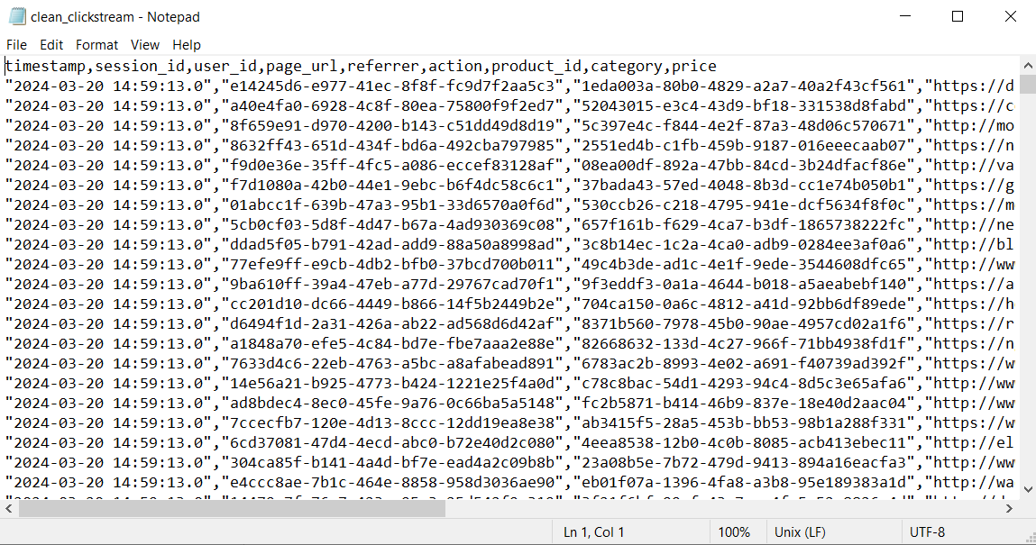
Dataset Before and After
Before
After

Slide 11
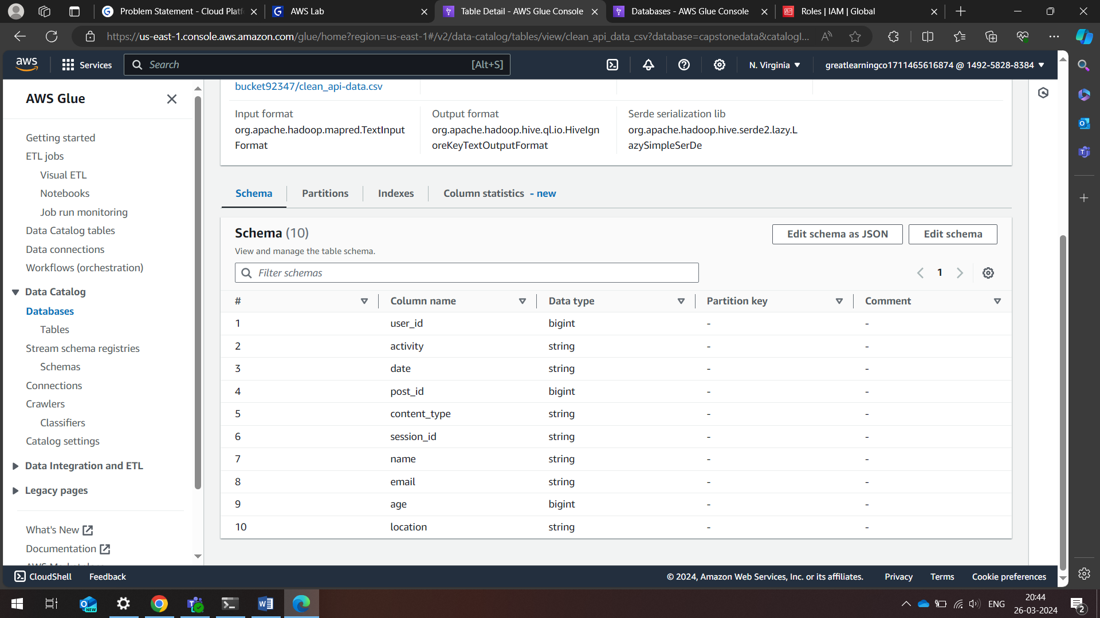
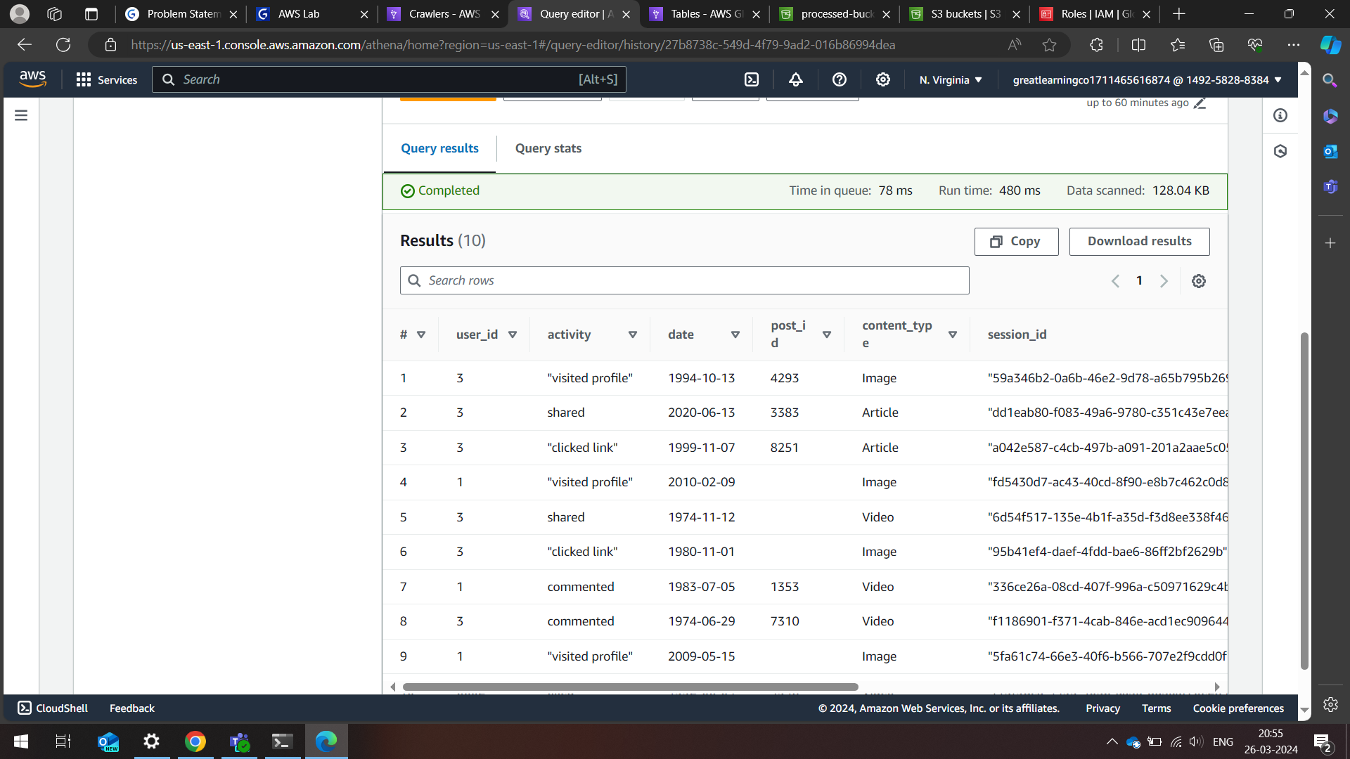
Step 3: Load
Create and manage data catalogs to provide a unified view of available data sources.
The Glue Crawler scans the data source, infers schema, and creates tables in the Glue Data Catalog.
Running the crawler on the cleaned CSVs to populate the tables in glue catalog.

Slide 12
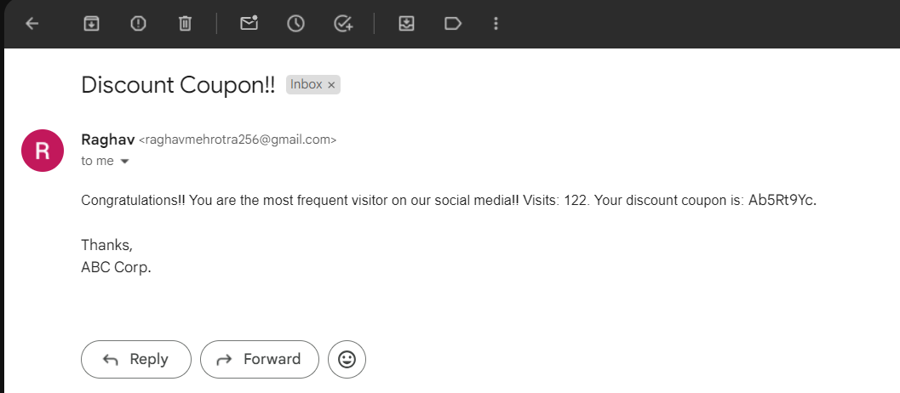
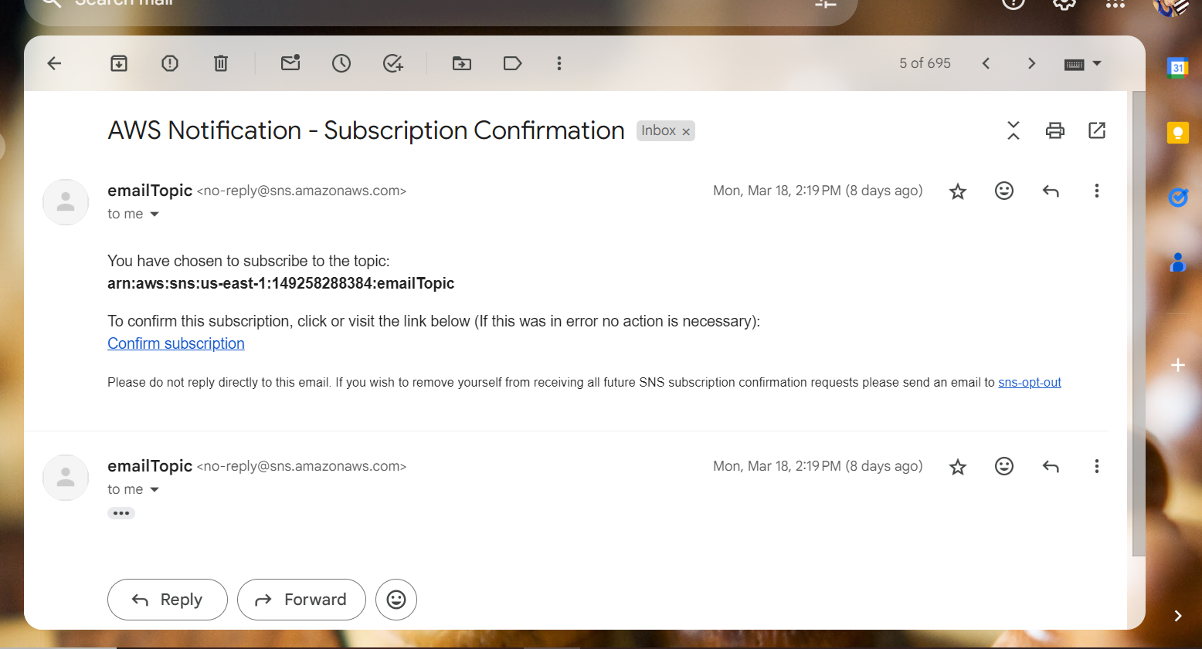
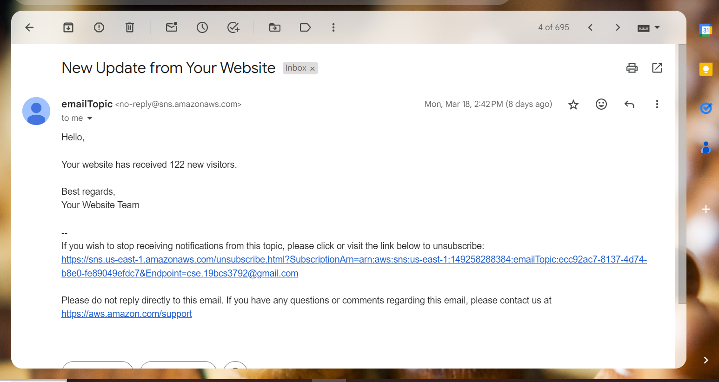
Communication
Communication to User using SMTP
Communication to Admin using SNS

Slide 13
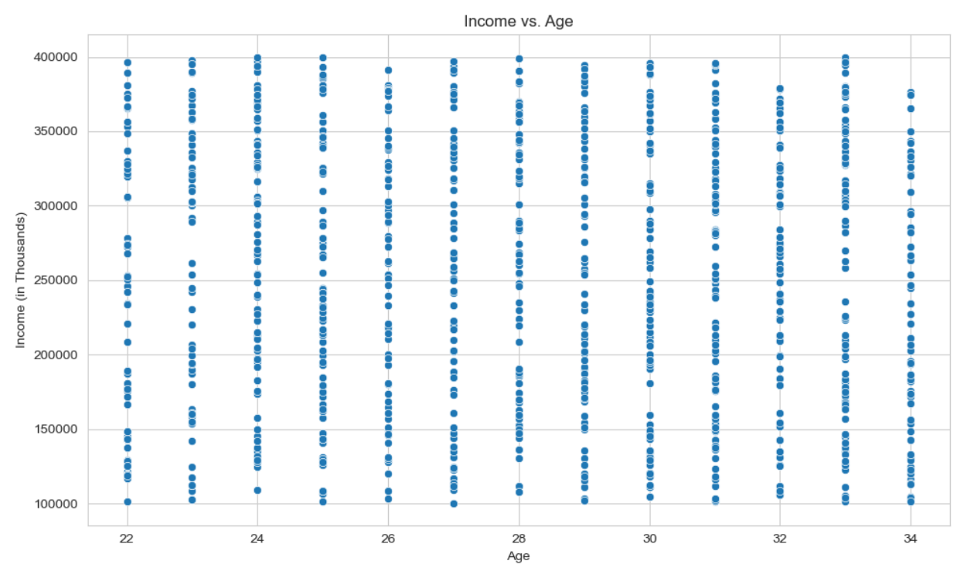
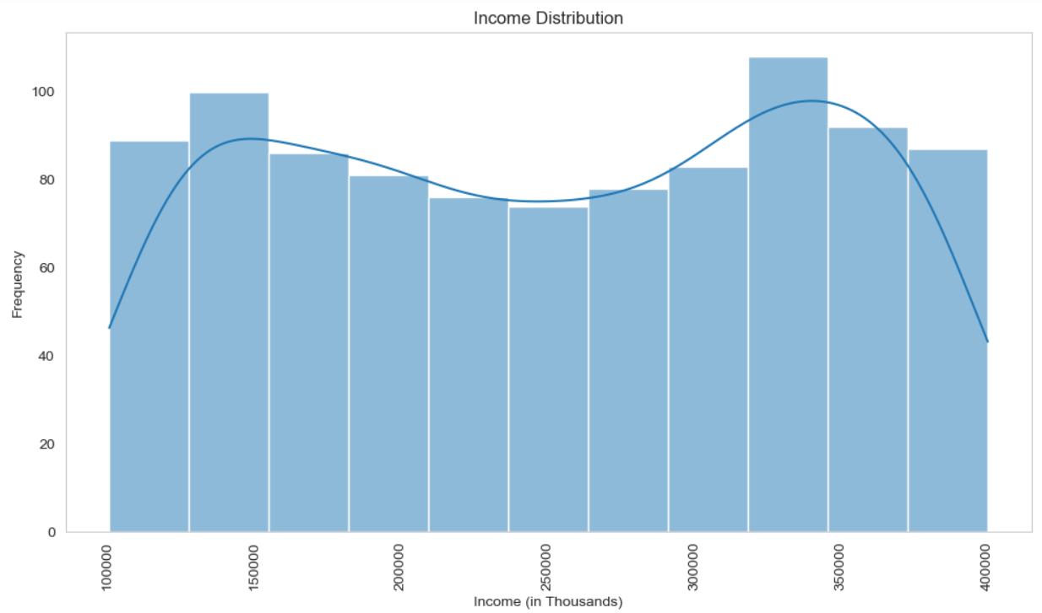
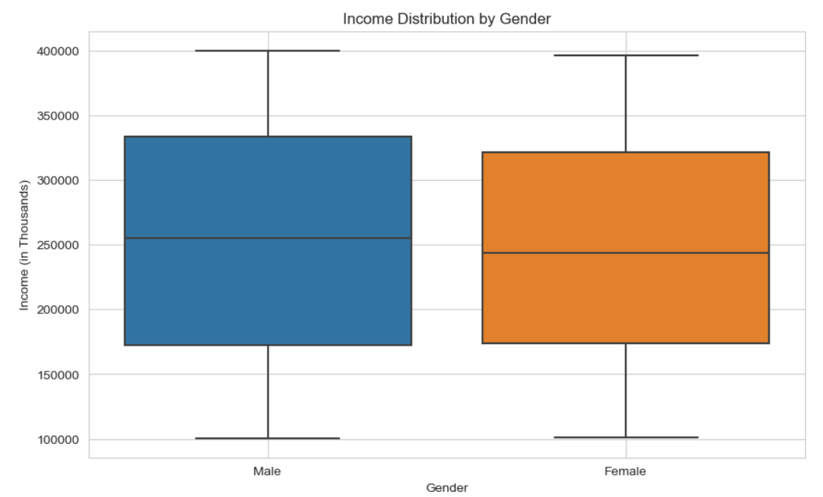
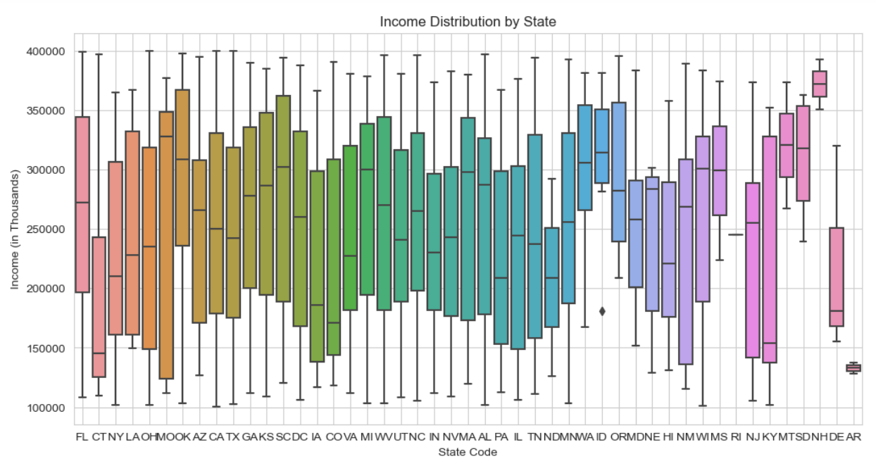
Customer Profile Dashboard

Slide 14
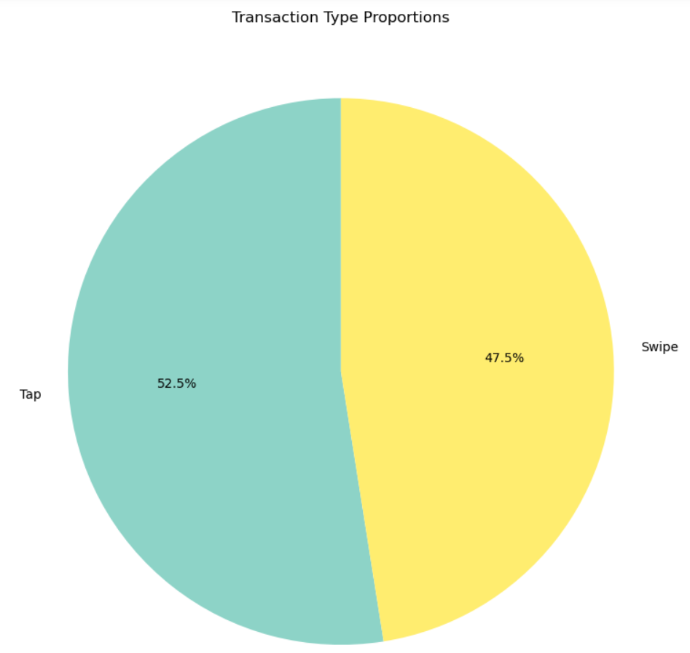
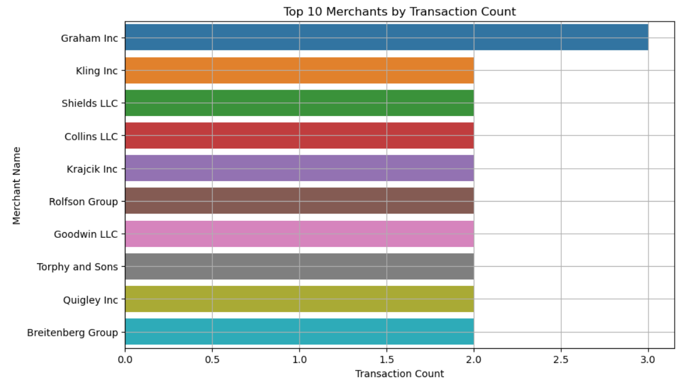
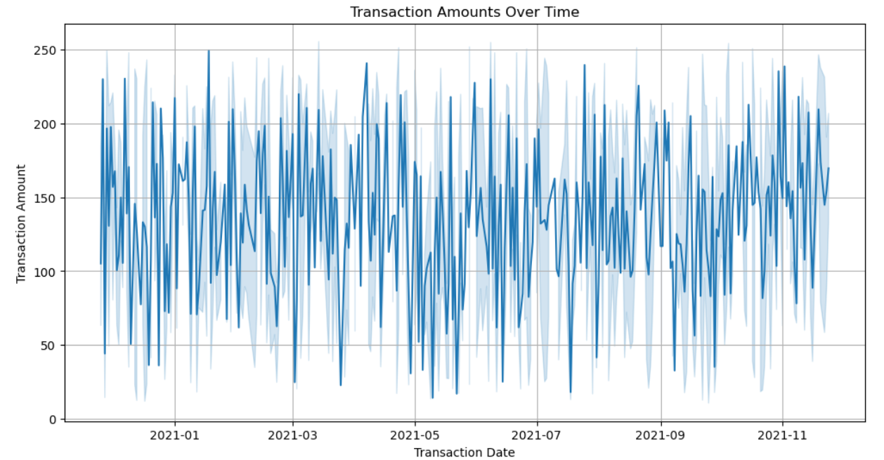
Customer Transactions Dashboard

Slide 15
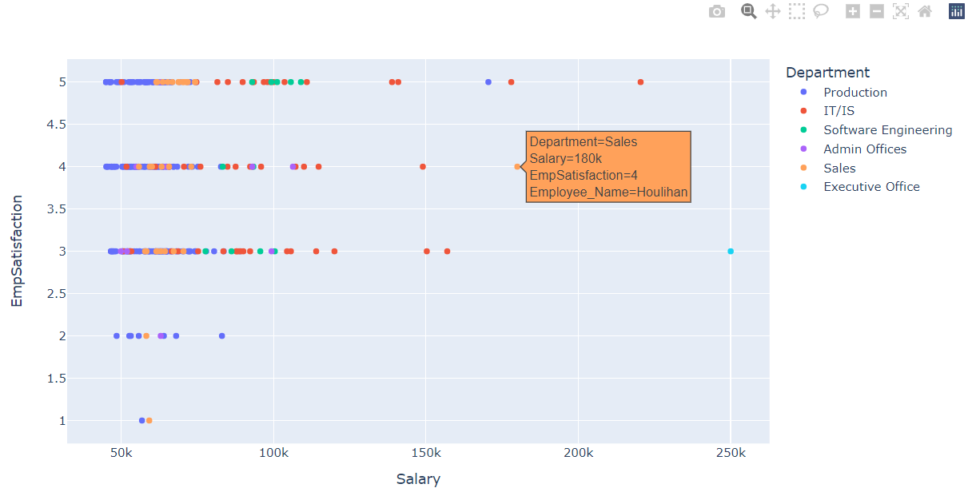
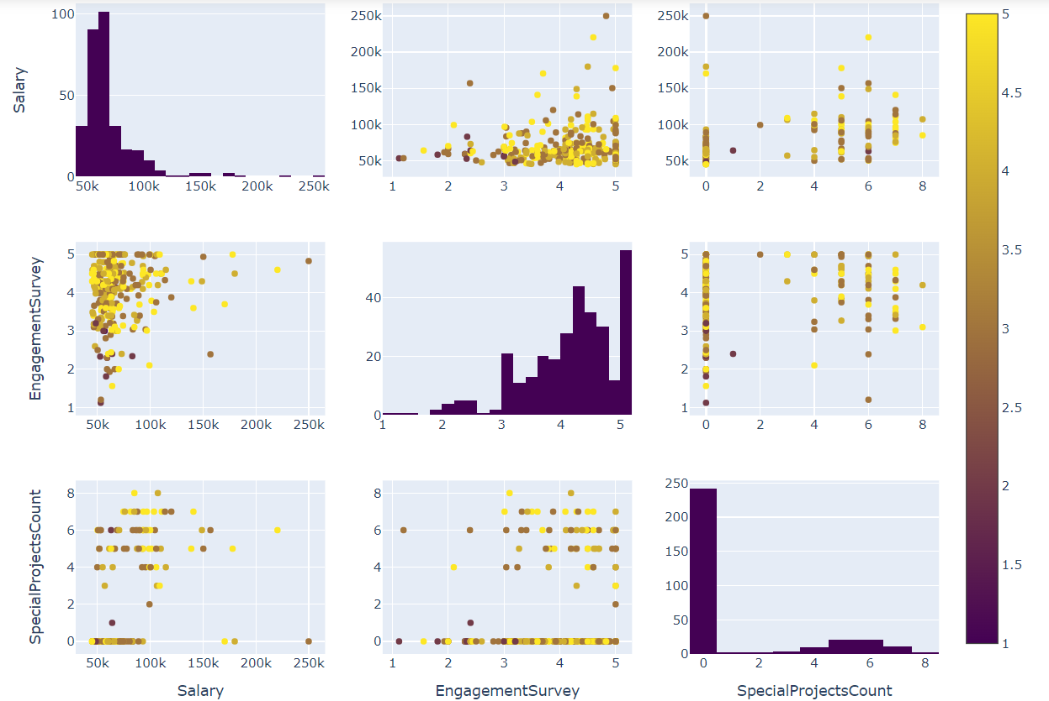
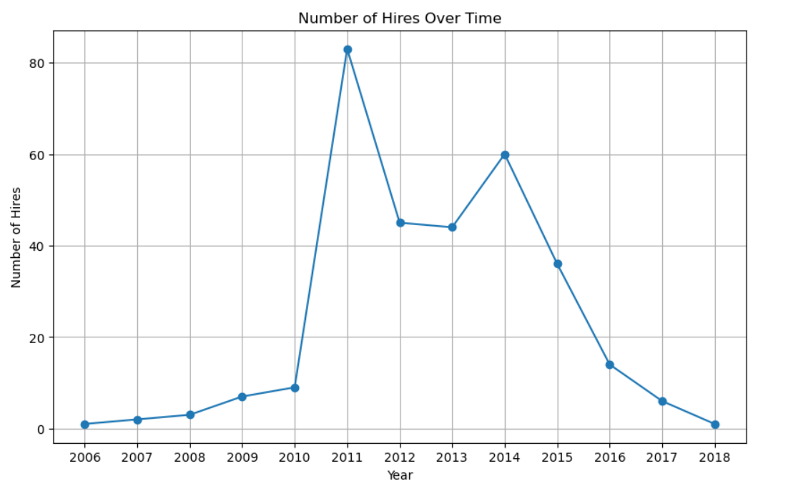
HR Data Dashboard

Slide 16
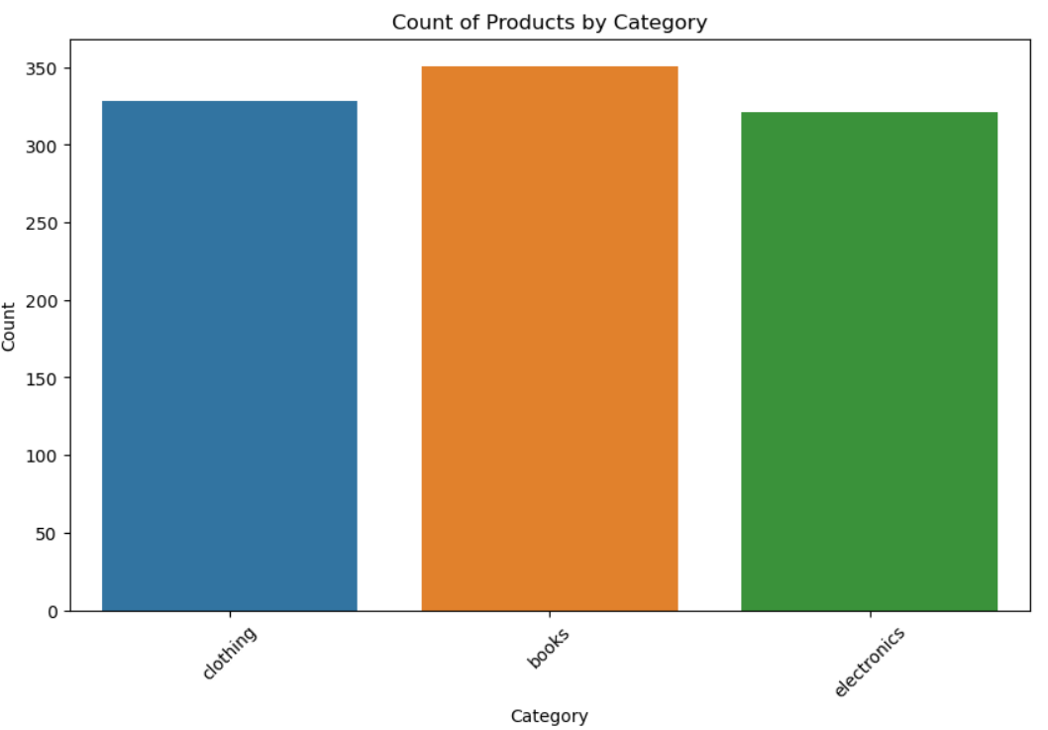
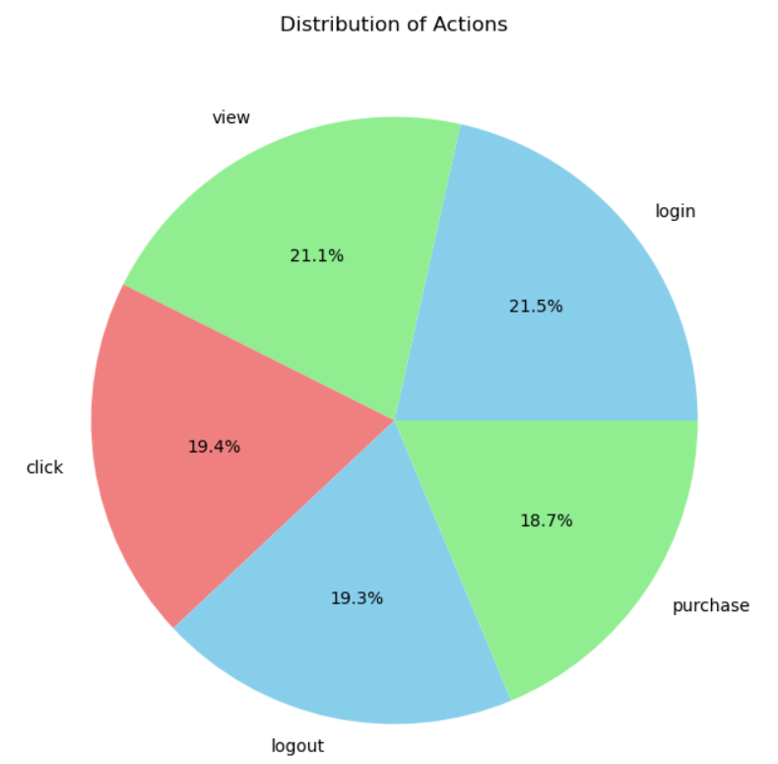
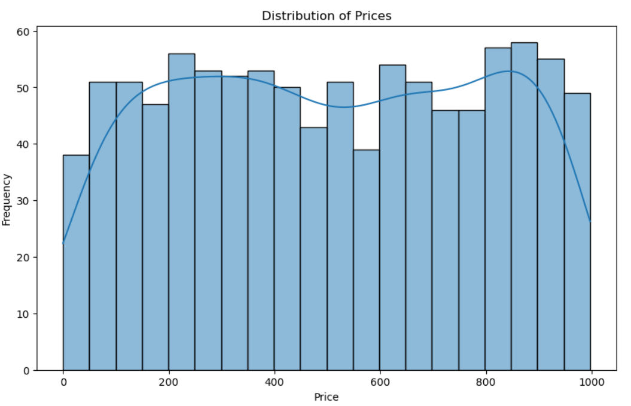
Clickstream Data Dashboard

Slide 17
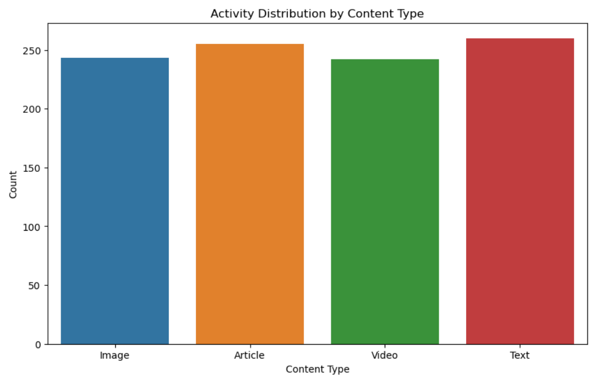
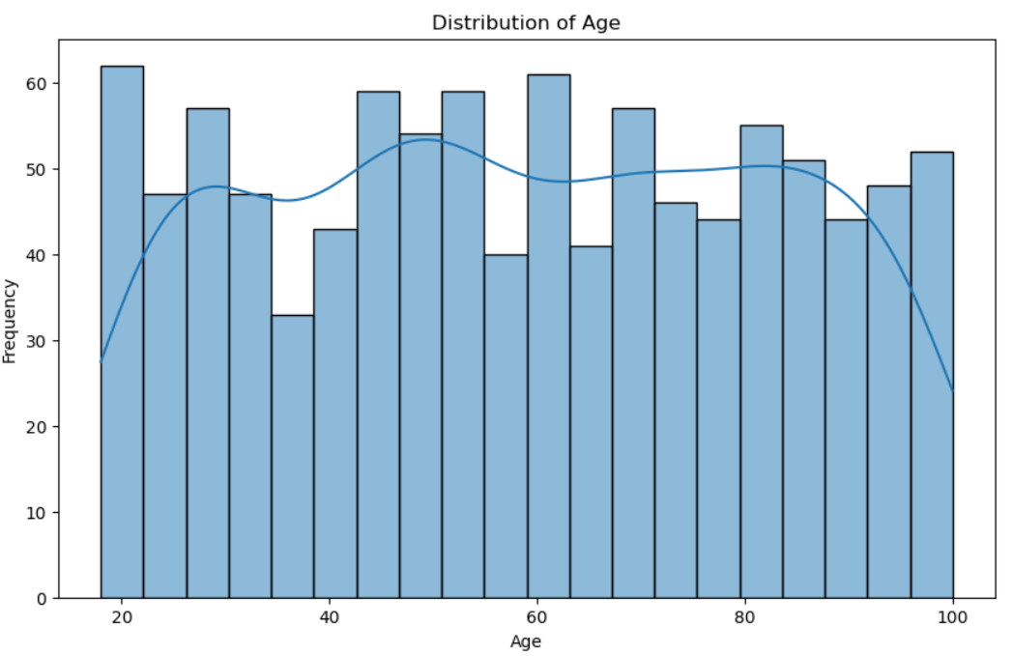
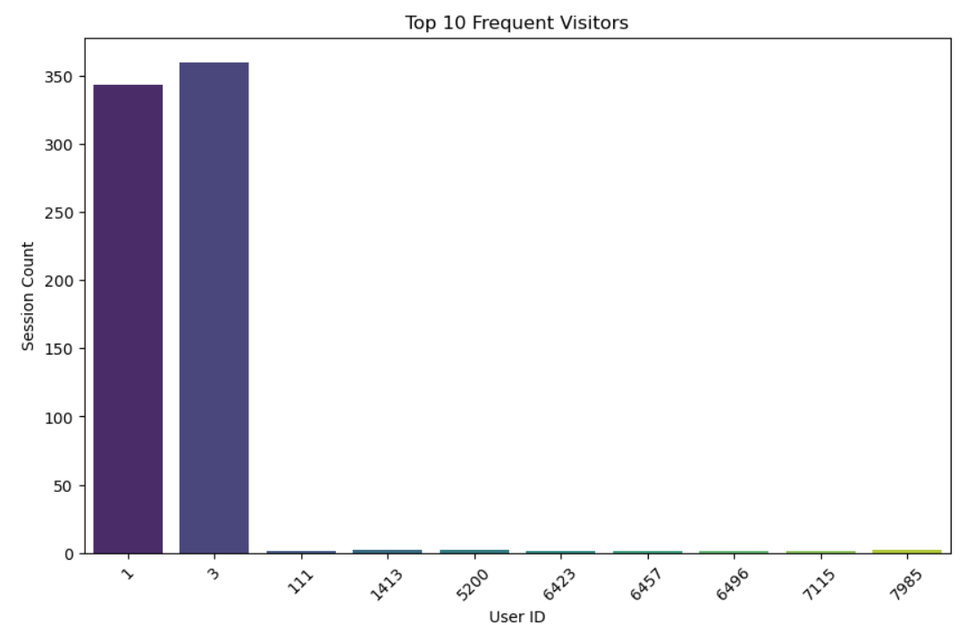
API Data Dashboard

Slide 18
Thank You
www.incedoinc.com

